Slide 1




Hate Crimes In the US
by TEAM
Orange
(Bryan, Stacy, Taylor, Angelique)

Slide 2


Overview of Project
Our insights were drawn from data provided by the FBI on hate crimes committed in the US between 1991-2020.

Slide 3



According to this dataset, there were 300,026 victims of hate crimes in the US between 1991-2020.

Slide 4

What Are Hate Crimes?
Hate crimes at the federal level are crimes driven by bias against race, color, religion, national origin, sexual orientation, gender, gender identity, or disability.
source: https://www.justice.gov/hatecrimes

Slide 5
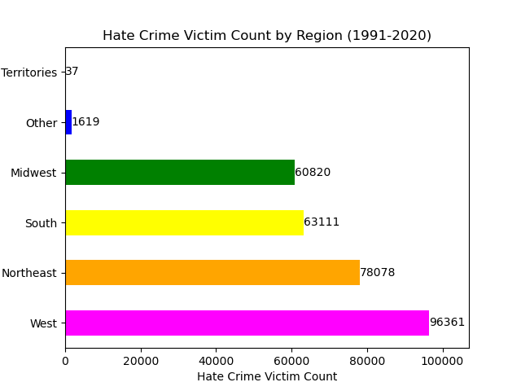

Breakdown of Victim Count by Region

Slide 6

Question(s) 1
What victim type experienced the most racially motivated hate crimes per region(Midwest, West, South, Northeast)? Is there any relationship between region and race based hate crimes?

Slide 7

Analysis
Victims who were black experienced the most racially motivated hate crimes across all regions.

Slide 8
Analysis Cont.
The values for each victim type are consistent and don't vary much throughout the four visualized regions.

Slide 9
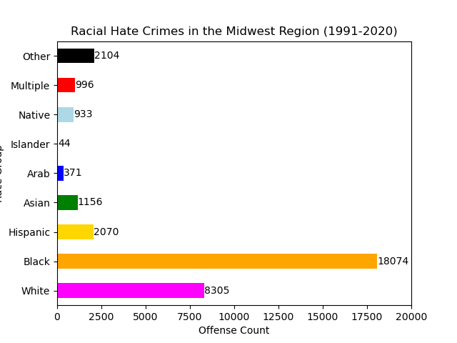

Slide 10
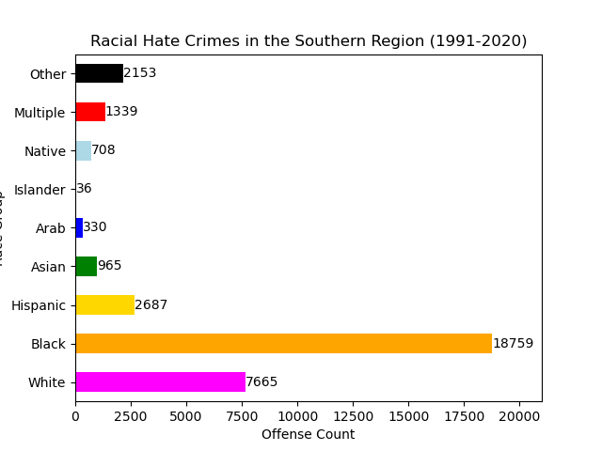

Slide 11
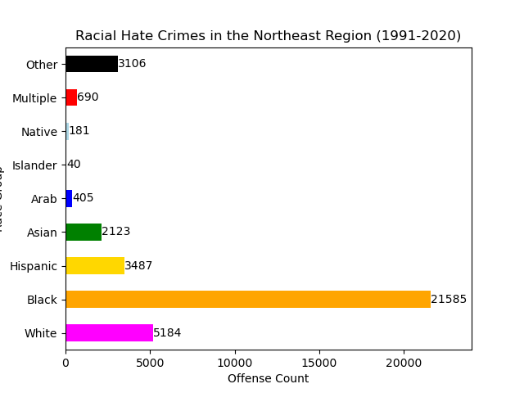

Slide 12
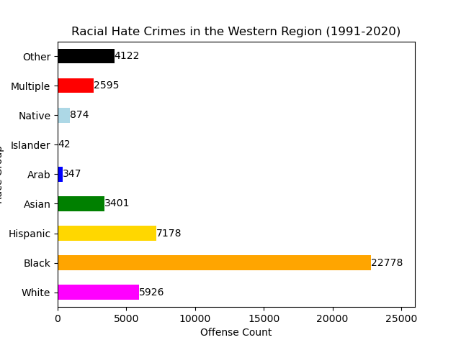

Slide 13
Question(s) 2
What offender type committed the most racial bias hate crimes ? How does this compare to local data from NC?

Slide 14
Analysis
The offender race deemed as "White" committed the most overall racial bias hate crimes.

Slide 15
Analysis Cont.
The bias description of "Anti-Black"
was the most common offensive type for white, Asian, and multiple-race offenders. The bias description of "Anti-White" was the most common offense type for native, islander, and black offenders.

Slide 16
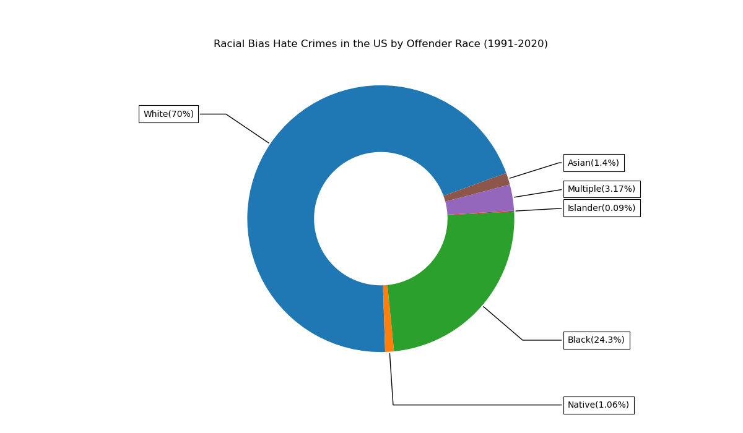

Slide 17
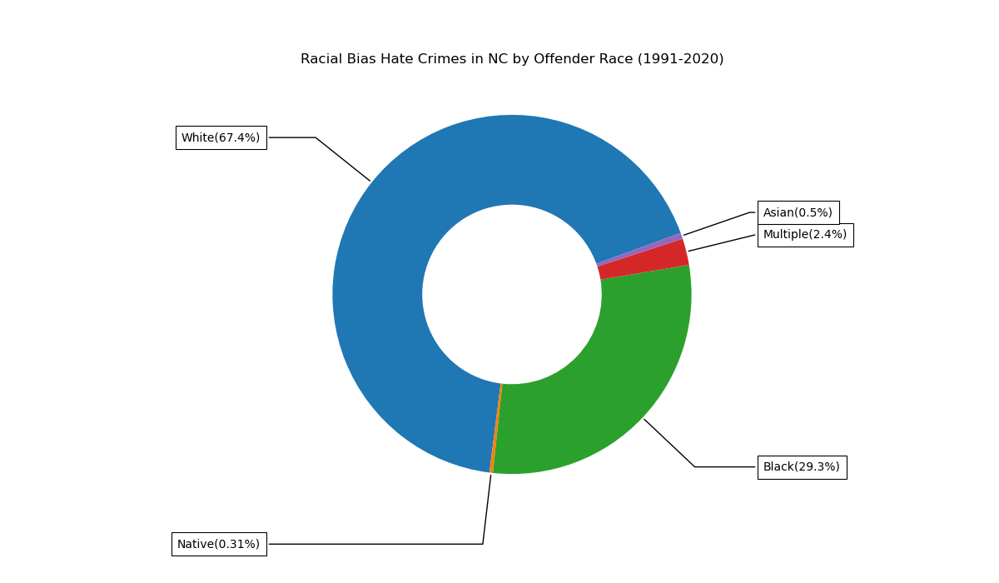

Slide 18
Analysis
Although the percentages are similar, the percentage of black offenders in NC is slightly higher than the national percentage. The percentage of white offenders in NC is slightly lower than the national percentage.

Slide 19
Question 3
What are the trends for hate crime incidents that were reported in the US and NC between 2016-2022?

Slide 20
Analysis
The number of reported hate crime incidents increased dramatically between 2016-2022. Nationally, there was a 26% increase from 2019-2020. In NC there was a 65% increase from 2018-2019.

Slide 21
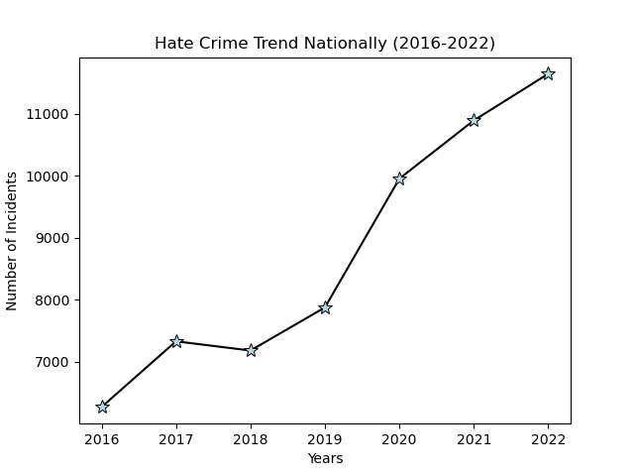

Slide 22
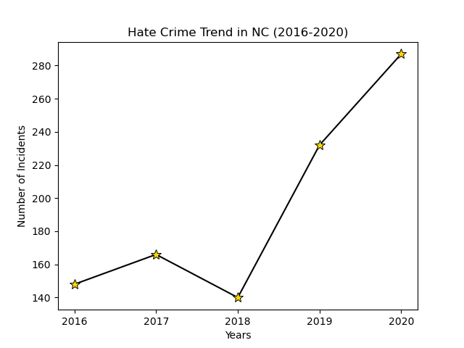

Slide 23
Question 4
Do most Hate crimes occur in Cities or Rural areas?

Slide 24
Analysis
Cities had higher numbers of Hate crime occurrences compared to Rural areas. With California being the state with the highest number of Hate crimes followed by New Jersey and New York which have one of the largest cities in the US

Slide 25
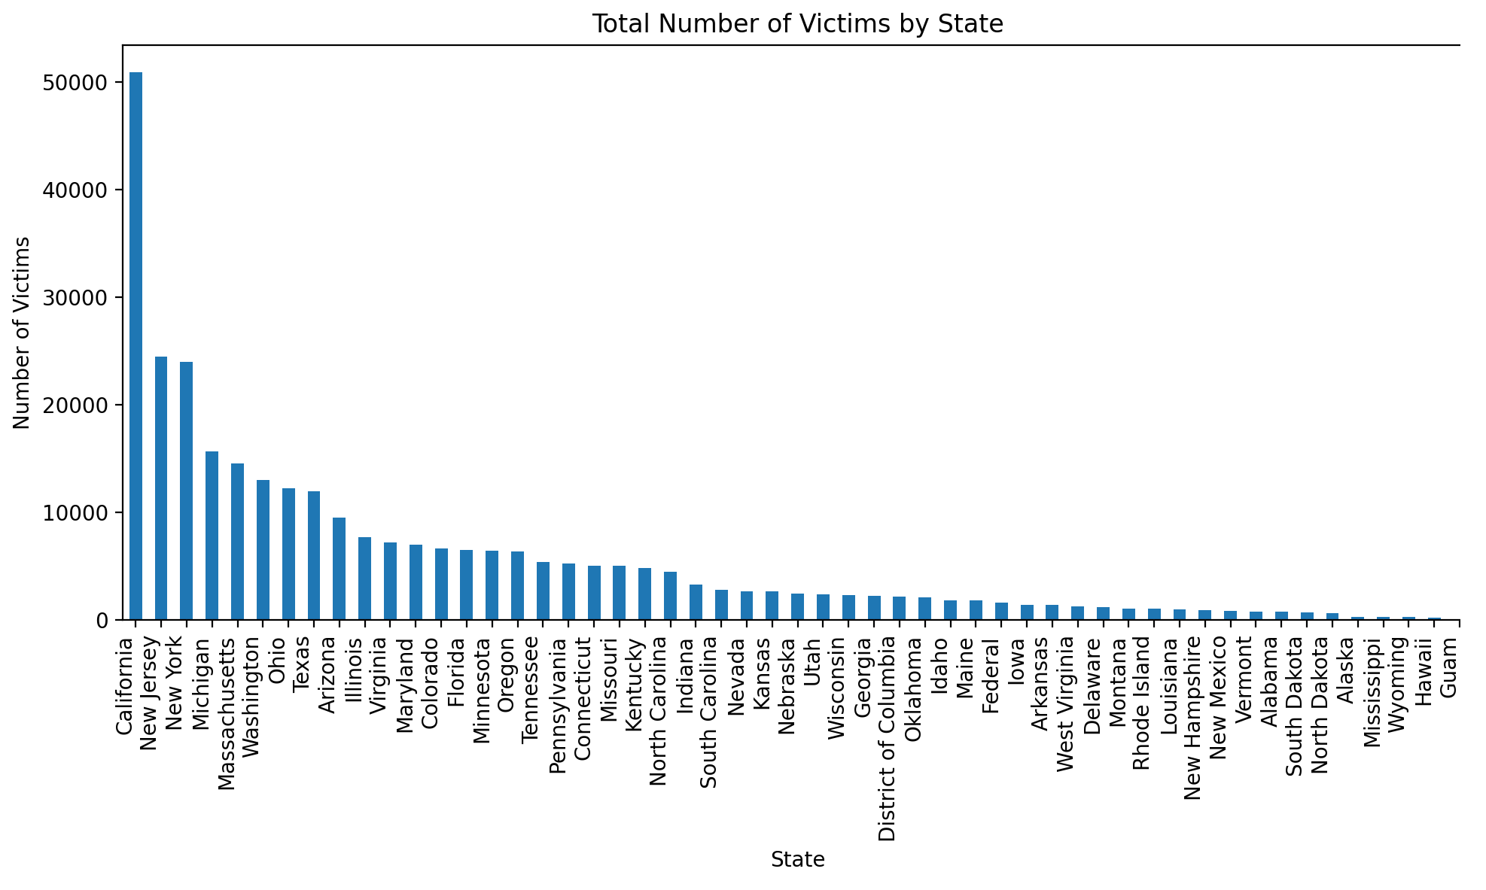

Slide 26
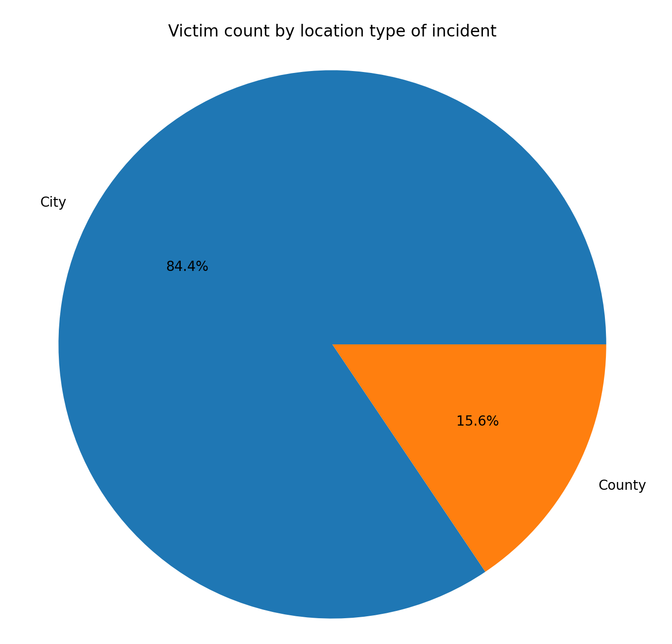

Slide 27
Question 5
Where did most of these Hate Crime related incidents occur?

Slide 28
Analysis
Most hate crimes are committed at a Residential/Home more than on the Street or sidewalk. The other locations of where these incidents occur are not exactly known but the 4th location with the most hate crimes is at a college or university area.

Slide 29
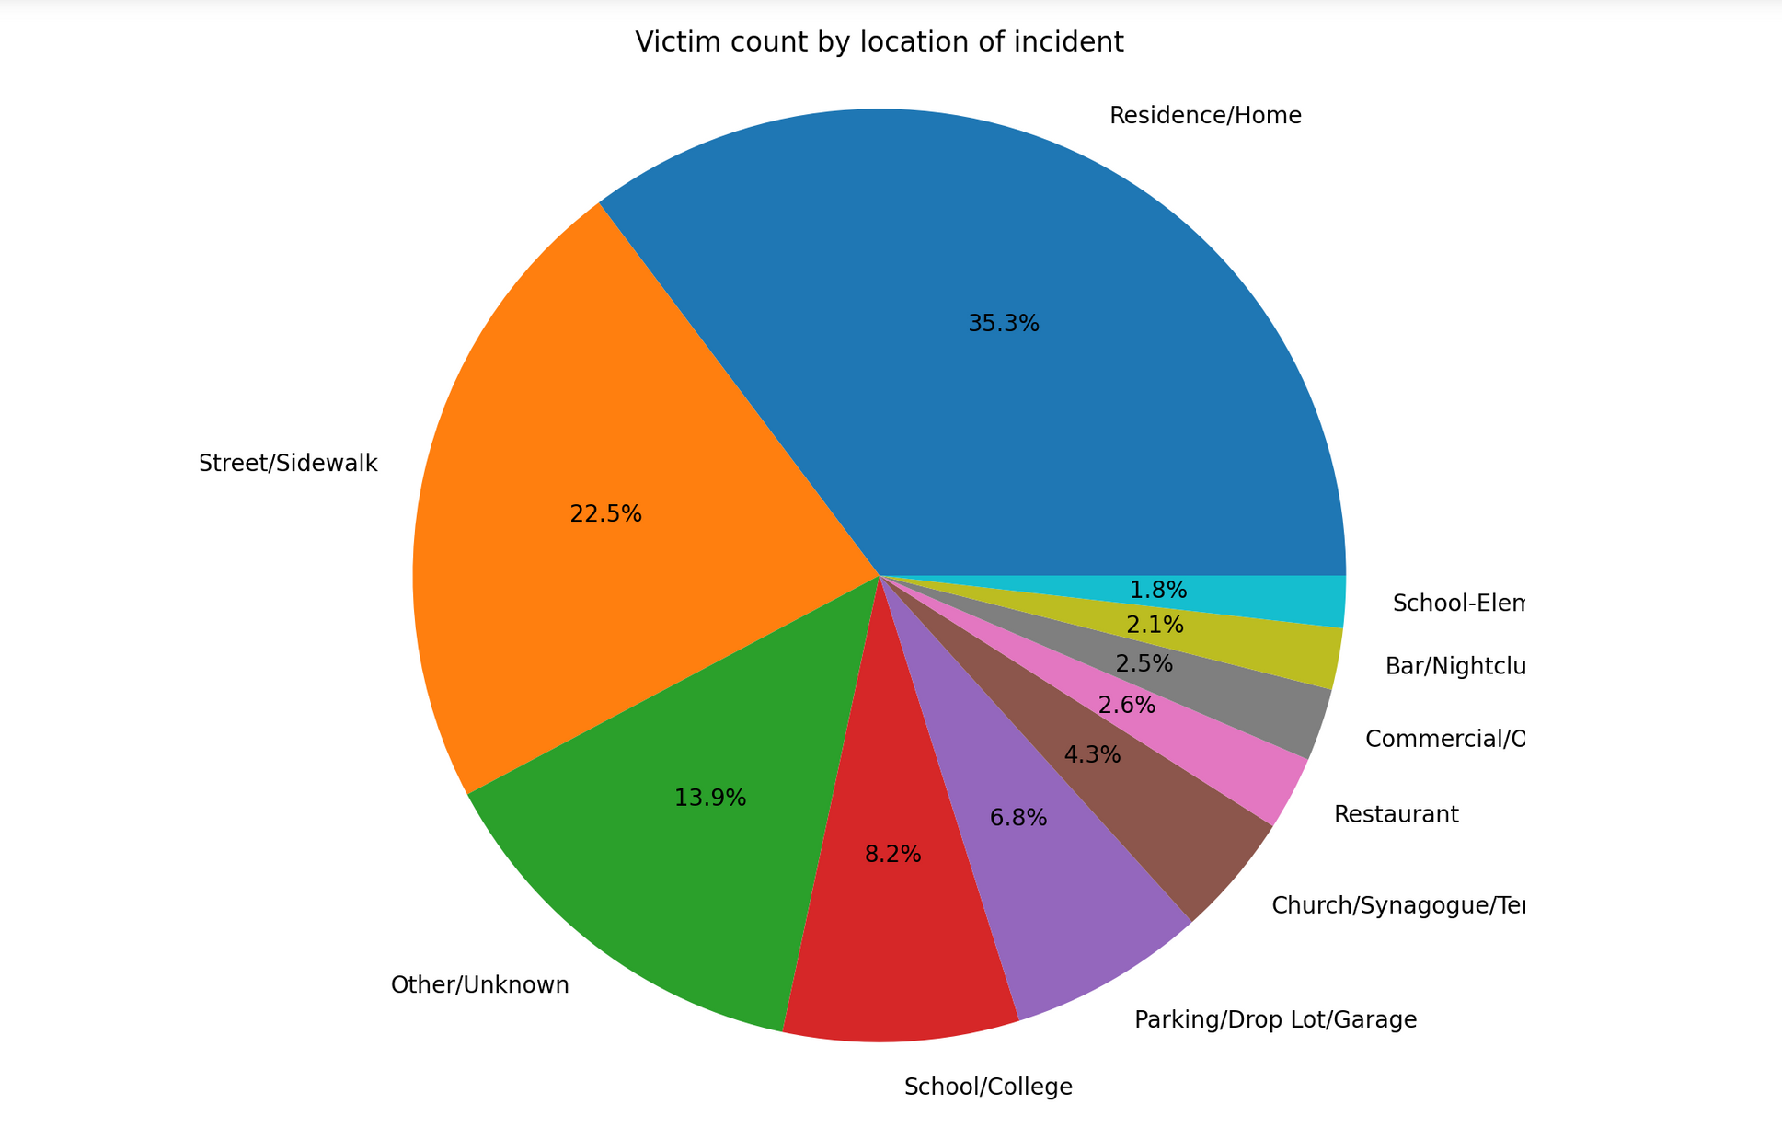

Slide 30
Question 6
What is the concentrated time/date of hate crime reports? How do the North Carolina numbers per month compare to the national numbers?

Slide 31
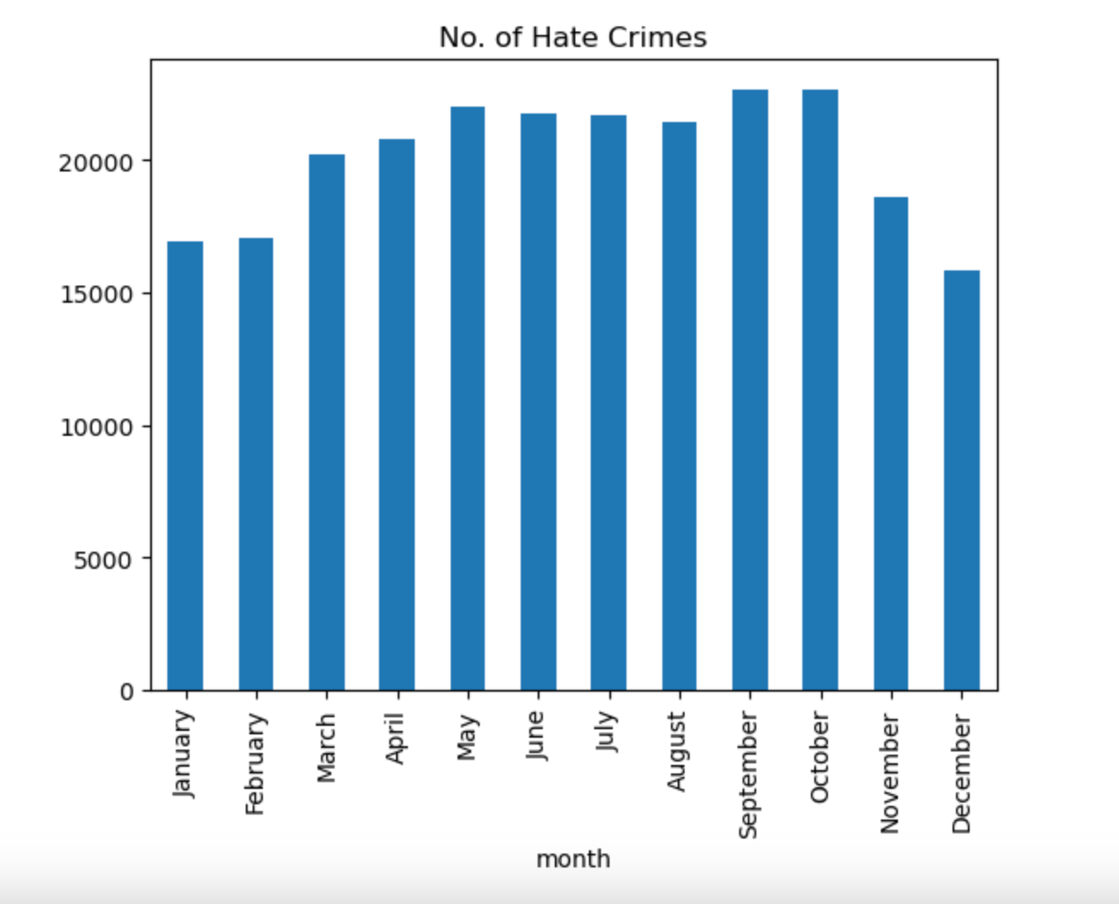

Slide 32
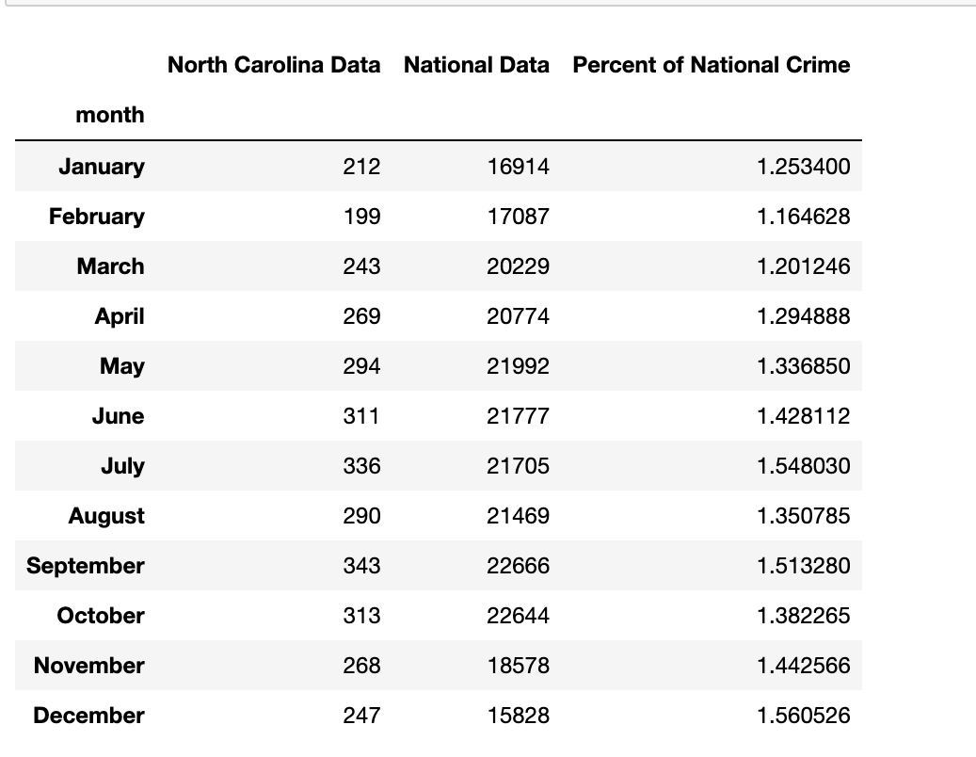

Slide 33
Analysis
Nationally, most hate crimes occurred in the month of September with October being the second highest by 22 incidents. The third highest month was May.

Slide 34
Analysis
North Carolina also had September as the highest month for incidents followed by July and October in the second and third spots.

Slide 35
Question 7
What is the Nation’s top 5 offenses of hate crime?

Slide 36
Analysis
Between 1991-2022, a total of 241,663 hate crimes were reported across the U.S.. Those reports were categorized into 53 types of hate crime offenses.
Below are the top 5 offenses:
Destruction/Damage/Vandalism
Intimidation
Simple Assault
Aggravated Assault
Robbery

Slide 37
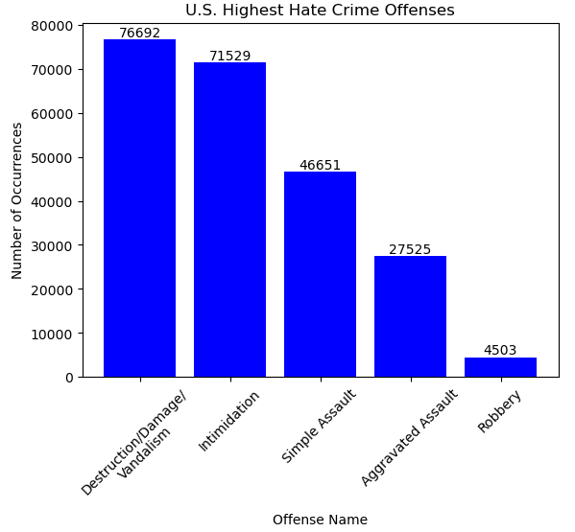

Slide 38
Analysis
Destruction/Damage/Vandalism and Intimidation make up approximately 1/3 each of the top 5 offenses above Simple Assault, Aggravated Assault, and Robbery, combined. While these offenses are significant, Simple Assault is not far behind, reaching the 3rd highest percentage and making up almost another 1/3 of all top 5 offenses.

Slide 39
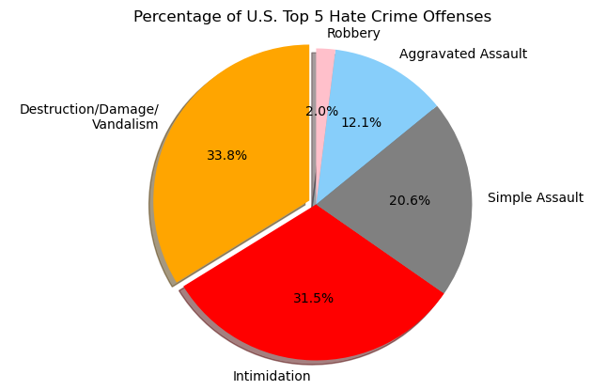

Slide 40
Sources:
FBI Crime Data Explorer Hate Crimes Statstics:
https://cde.ucr.cjis.gov/LATEST/webapp/#
City of Charlotte - Open Data Portal:
https://data.charlottenc.gov/

Slide 41

Thank you!

